Slide 1
Occlusion with Data Augmentation
(Pattern Recognition Project)
SUBMITTED TO-
ANKIT SHARMA
INDIAN INSTITUTE OF INFORMATION TECHNOLOGY KOTA

Slide 2
TABLE OF CONTENTS
1.Introduction
2.Occlusion
3.Data Augmentation
4.Heavy reliance on distinctive patterns
5.Previous Methods
6.Hide and seek
7.Grid mask
8.Future Improvement

Slide 3
Introduction
Robustness to occlusions is an important property of image recognition system
Data augmentation in solving the occlusion problem
Previous methods involved in the discipline

Slide 4
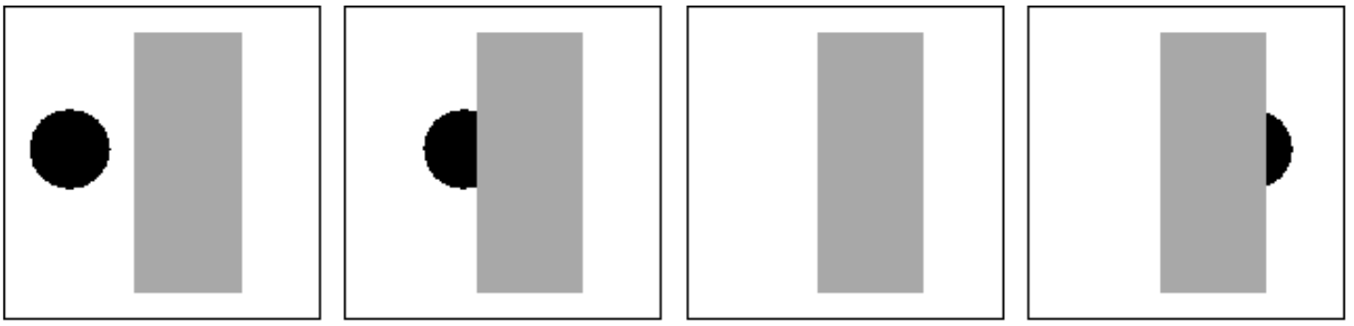
Occlusion
In its simplest terms, Occlusion means that there is something we want to see, but can't due to some property of our sensor setup, or some event.
In the following sequence we can see how the object of interest (circle) is obstructed partially and completely by the rectangle

Slide 5
Data augmentation
Image Data Augmentation is a technique that can be used to artificially expand the size of a training dataset by creating modified versions of images in the dataset.
Training deep learning neural network models on more data can result in more skillful models.
Data Augmentation in Image can be achieved by using following techniques -
1.Shift Augmentation
2.Flip Augmentation
3.Rotation Augmentation
4.Zoom Augmentation

Slide 6
Data augmentation
Benefits of Data Augmentation -
1.Improving Model Prediction Accuracy
2.Preventing Data Scarcity for better models
3.Reducing Data Overfitting
4.Helping in resolving class imbalance issues in classification
5.Reducing cost of labeling dataset

Slide 7
Heavy reliance on distinctive patterns
Datasets used in training high performance models are affected by the ‘photographer bias’
Over reliance on obvious features of the object rather than the more subtle ones can cause the models to become ‘lazy’
Data augmentation can effectively counter this
Notes:
By generating new images which simulate occluded examples, we not only better prepare the model for encounters with occlusions in the real world, but the model also learns to take more of the image context into consideration when making decisions.

Slide 8
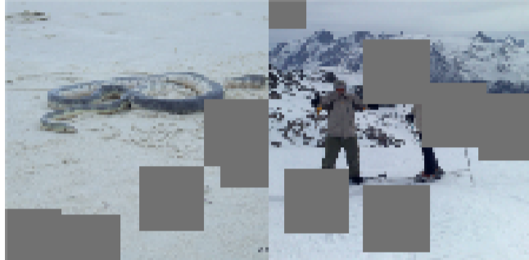
Previous methods of data augmentation- Cutout
This method involves removing contiguous sections of input images, effectively augmenting the dataset with partially occluded versions of existing samples.
One of the major differences between cutout and other dropout variants is that units are dropped at the input stage of the network rather than in the intermediate layers
Notes:
When cutout is applied to an image, we randomly select a pixel coordinate within the image as a center point and then place the cutout mask around that location. This approach has the effect that visual features, including objects that are removed from the input image, are correspondingly removed from all subsequent feature maps.

Slide 9
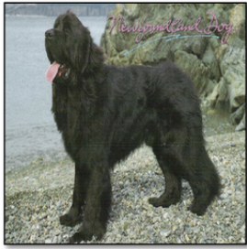
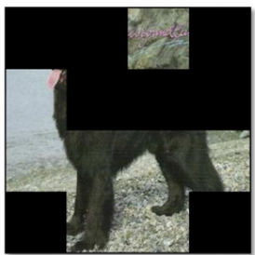
Hide and seek
This method hides patches from an image during training so that the model needs to seek the relevant object parts from what remains.
It divides the image into a square grid and and “drops” grid patches independently
Notes:
Before we send it to a CNN for detection

Slide 10
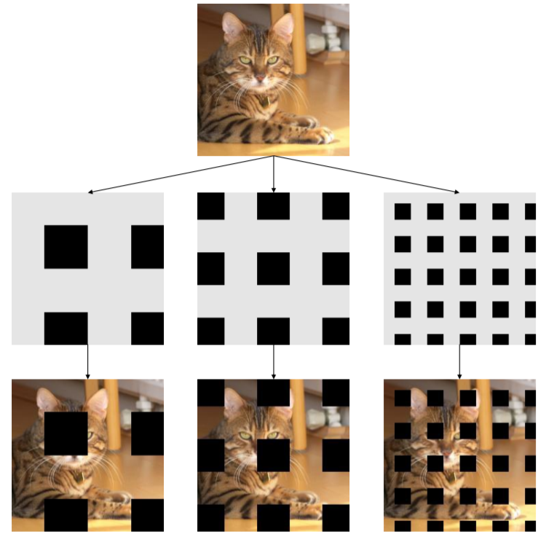
Grid mask
This method involves deleting regions in only a set of spatially uniformly distributed squares.
Notes:
It is a slightly different version of hide and seek

Slide 11
FUTURE IMPROVEMENTS
We can implement Real-Time image recognition system using Open-cv which will identify the image directly from video. This will help traffic management in big cities.
Further research could also be done on other kinds of occlusions, such as blur or random noise

Slide 12
THANK YOU
Submitted By-
Swapnil Singh(2018KUCP1029)
Rahul Kumar Yadav(2018KUCP1073)

